Slide 1
STARTUP PROFIT ANALYSIS
Power BI Dashboard & Regression Analy sis
Name: Piyush
Batch ID: 23-FEB-26-CDA-BUN-040-WDM0900-BAN-MAR
Team ID: PTID-CDA-JUN-26-11165
Course: CDA
Project ID: PRDA-01

Slide 2


PROBLEM UNDERSTANDING
OBJECTIVE:
The analysis aims to answer:
Which spending category impacts profit the most? Which state generates the highest profit?
Can profit be predicted using Linear Regression?
What insights can help startups allocate budgets more efficiently?

Slide 3
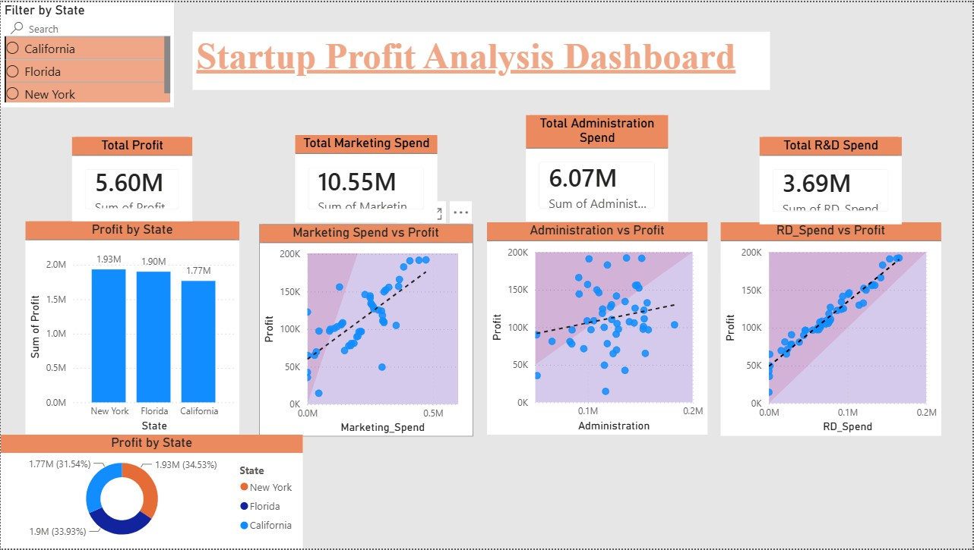
DASHBOARD:
KPI Cards display total investments and profit.
Scatter plots show relationship between expenses and profit.
State slicer enables interactive filtering.
Trend lines highlight correlation between variables.
Interactive Power BI Dashboard

Slide 4

DASHBOARD INSIGHTS:
R&D Spend has the strongest positive relationship with profit.
Marketing Spend has a moderate positive effect. Administration Spend shows a weak relationship with profit. New York contributes the highest total profit among all states. Profit changes dynamically using the State slicer.

Slide 5
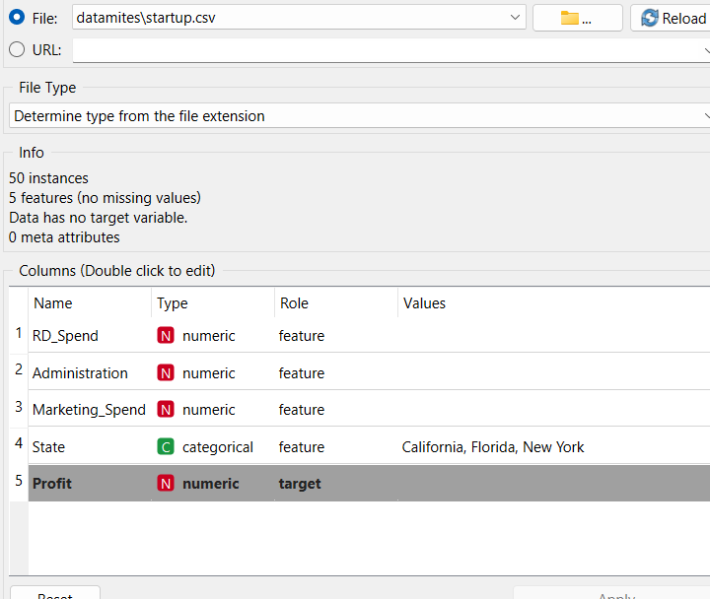
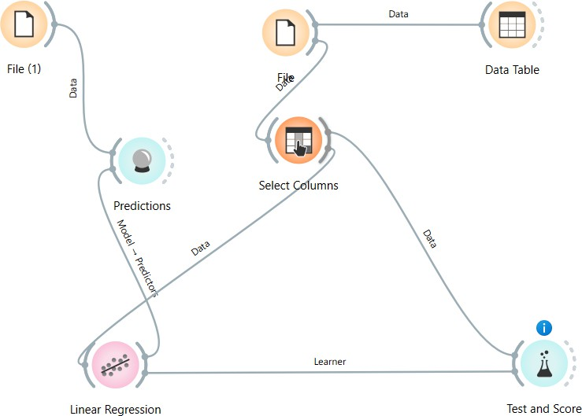
REGRESSION ANALYSIS:
Target Variable: Profit
Features Used:
R&D Spend
Marketing Spend
Administration
Model: Linear Regression
Details of Dataset
Workflow Screenshot

Slide 6
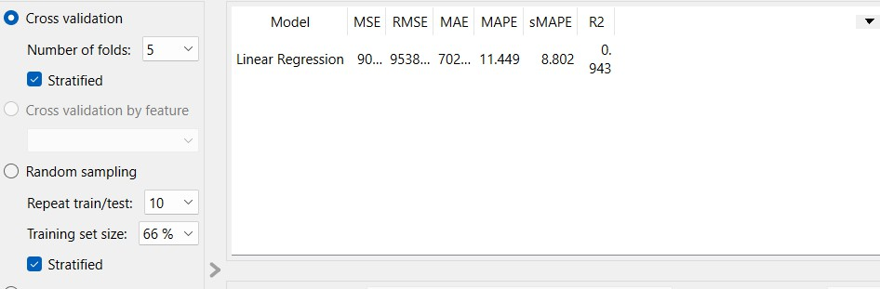
REGRESSION ANALYSIS:
EVALUATION:
Cross Validation (5 folds)
R² = 0.943
RMSE ≈ 9538
MAPE ≈ 11.45%
Test & Score screenshot
INTERPRETATION:
The model explains approximately 94.3% of the variance in startup profit, indicating strong predictive performance.

Slide 7
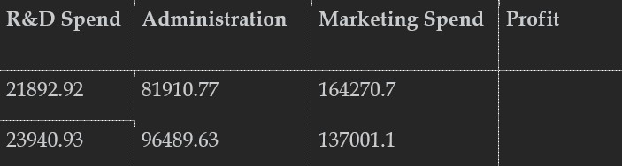
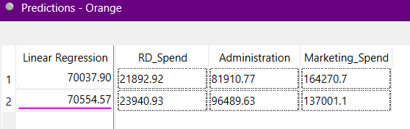
PREDICTION RESULTS:
Input Table Profit Prediction for Input Table using Orange
KEY OBSERVATIONS:
Successfully predicted profit for the two startup investment combinations provided in the assignment using the Linear Regression model. Prediction 1:
R&D = 21,892.92, Administration = 81,910.77, Marketing = 164,270.70
Predicted Profit: 70,037.90
Prediction 2:
R&D = 23,940.93, Administration = 96,489.63, Marketing = 137,001.10
Predicted Profit: 70,554.57
The model achieved an R² score of 0.943, indicating high predictive accuracy and making it suitable as a decision-support tool for estimating startup profit based on investment patterns.

Slide 8
CONCLUSION & RECOMMENDATIONS:
CONCLUSION:
R&D investment is the strongest driver of startup profit. Marketing has a noticeable positive impact.
Administration spending contributes comparatively less. Linear Regression provides reliable profit predictions.
Power BI enables interactive business analysis.
RECOMMENDATIONS:
Increase investment in R&D for higher profitability. Optimize marketing budgets.
Monitor administrative expenses.
Use predictive analytics before making investment decisions.

